Slide 1
An Architecture for Federated Cloud Computing
Introduction
A Typical Use Case
A Model for Federated Cloud Computing
Security Considerations

Slide 2
Introduction
Cloud computing - rapidly gaining momentum as an alternative to traditional IT, and the reasons are:
Allows individuals & companies to fulfil all their IT needs with minimal investment and controlled expenses (both capital and operational).
Cloud computing enables companies and individuals to lease resources on-demand from a virtually unlimited pool.
The “pay as you go” billing model applies charges for the actually used resources per unit time.
This way, a business can optimize its IT investment and improve availability and scalability.

Slide 3
While cloud computing holds a lot of promise for enterprise computing, there are a number of inherent deficiencies such as:
Inherently Limited Scalability of Single-Provider Clouds:
Although most infrastructure cloud providers claim infinite scalability, in reality, they start facing scalability problems as cloud computing usage rate increases.
Lack of Interoperability Among Cloud Providers:
Contemporary cloud technologies have not been designed with interoperability in mind.
In addition, it prevents small and medium cloud infrastructure providers from entering the cloud provisioning market.
No Built-In Business Service Management Support:
Business Service Management (BSM) is a management strategy that allows businesses to align their IT management with their high-level business goals.
Current cloud computing solutions are not designed to support the BSM practices.

Slide 4
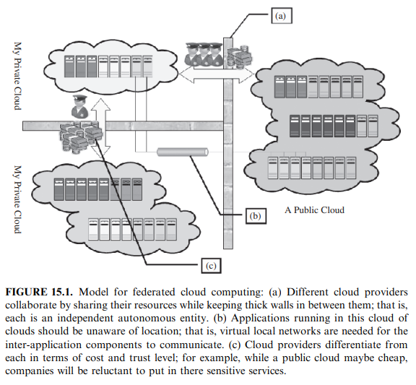
To address these issues, a model for business-driven federation of cloud computing providers is presented here, where each provider can buy and sell, on-demand, capacity from other providers (see Figure 15.1).

Slide 5
SAP Systems
A Typical Use Case
SAP systems are used for a variety of business applications that differ by version and functionality [such as customer relationship management (CRM) and enterprise resource planning (ERP)].
For a given application type, the SAP system components consist of generic parts customized by configuration & parts custom-coded for a specific installation.
Certain SAP applications are composed of several loosely coupled systems.
Such systems have independent databases and communicate asynchronously by message with each other.

Slide 6
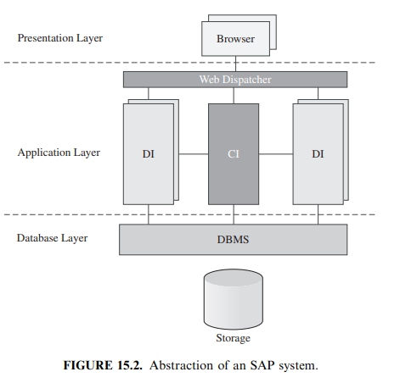
An SAP system is a typical three-tier system (see Figure 15.2) as follows:
Requests are handled by the SAP Web dispatcher.
In the middle tier, there are two types of components: multiple stateful dialog instances (DIs) & a single central instance (CI) that performs central services such as application-level locking, messaging, and registration of DIs.
A single database management system (DBMS) serves the SAP system

Slide 7
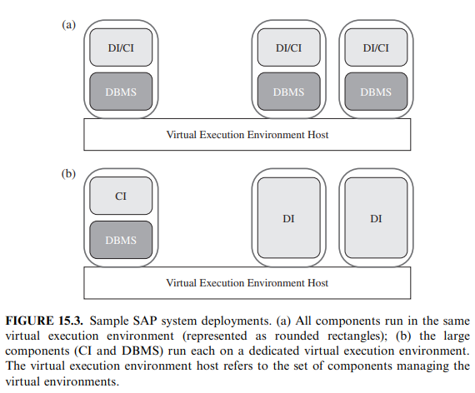
The components can be arranged in a variety of configurations, from a minimal configuration where all components run on a single machine, to larger ones where there are several DIs, each running on a separate machine, and a separate machine with the CI and the DBMS (see Figure 15.3)

Slide 8
The Virtualized Data Center Use Case
Consider a data center that consolidates the operation of different types of SAP applications and all their respective environments (e.g., test, production) using virtualization technology.
The applications are offered as a service to external customers, or, alternatively, the data center is operated by the IT department of an enterprise for internal users (i.e., enterprise employees).
A special variation is when the data center serves an on-demand, Software as a Service (SaaS) setup, where customers are external and where each customer (tenant) gets the same base version of the application.
However, each tenant configures and customizes the application to suit his specific needs.

Slide 9
Few aspects that are typical of virtualized data centers: Infrastructure provider must manage the life cycle of the application for hundreds or thousands of tenants while keeping a very low total cost of ownership (TCO).
This includes:
- setting up new tenants,
- backing up the databases,
- managing the customizations & configurations of tenants,
- newer versions of the software from SAP (the service provider).
Setting up a new tenant in the SaaS for SMBs case is completely automated by a Web-based wizard.
The new tenant runs through a series of configuration questions and uploads master data items.
Following these steps, the tenant is up and running, typically using a trial version.
The customers are billed a fixed monthly subscription fee or a variable fee based on their usage of the application.

Slide 10
Primary Requirements
From the use case discussed in the previous section, we derived the following main requirements from a cloud computing infrastructure:
Automated and Fast Deployment: The cloud should support automated provisioning of complex service applications based on infrastructure SLAs.
The same contract should be reused to provision multiple instances of the same application for different tenants with different customizations.
Dynamic Elasticity: The cloud should dynamically adjust resource allocation parameters (memory, CPU, network bandwidth, storage) of individual virtual execution environments seamlessly.
Also, the number of virtual execution environments must be adjusted to adapt to the changing load.
Automated Continuous Optimization: The cloud should continuously optimize alignment of infrastructure resources management with the high-level business goals.

Slide 11
A model for Federated Cloud Computing
In our model for federated cloud computing, major types of actors are: Service Providers (SPs) & Infrastructure Providers (IPs).
Service Providers:
- are entities that need computational resources to offer some service.
- However, SPs do not own these resources;
- instead, they lease them from Infrastructure Providers (IPs).
Service Application
- a set of software components that work collectively to achieve a common goal.
- Each component of such service applications executes in a dedicated (Virtual Execution Environment) VEE.
SPs deploy service applications in the cloud by providing Service Manifest to a IP, known as the primary site.
Service Manifest - is a document that defines the structure of the application as well as the contract and SLA between the SP and the IP.

Slide 12
To create the illusion of an infinite pool of resources, IPs shares their unused capacity with each other to create a federation cloud.
Framework Agreement
- is a document that defines the contract between two IPs.
- It states the terms and conditions under which one IP can use resources from another IP.
Within each IP, optimal resource utilization is achieved by partitioning physical resources, through a virtualization layer, into Virtual Execution Environments (VEEs)
VEE’s are fully isolated runtime environments that abstract away the physical characteristics of the resource and enable sharing.
Virtual Execution Environment Host (VEEH) –
virtualized computational resources + virtualization layer + all the management enablement components.

Slide 13
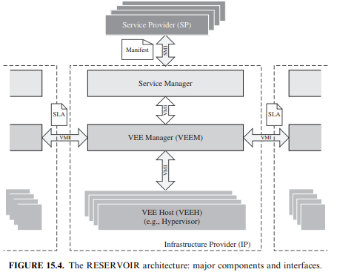
A reference architecture for federated cloud computing:
The design and implementation of such architecture are the main goals of the RESERVOIR European research project.
The RESERVOIR architecture - identifies the major functional components needed within an IP to fully support the cloud computing paradigm.

Slide 14
The Service Manager is the only component within an IP that interacts with SPs.
It receives Service Manifests, negotiates pricing, and handles billing.
Its two most complex tasks are:
(1) deploying & provisioning VEEs based on the Service Manifest
(2) monitoring & enforcing SLA compliance
The Virtual Execution Environment Manager (VEEM) is responsible for placement of VEEs into VEE Hosts
(as per constraints determined by the Service Manager)
VEEM is free to place and move VEEs anywhere, even on the remote sites (subject to overall cross-site agreements), as long as it satisfies the constraints.
Thus, in addition to serving local requests (from the local Service Manager), VEEM is responsible for the federation of remote sites.

Slide 15
The Virtual Execution Environment Host (VEEH) is responsible for the basic control and monitoring of VEEs and their resources
- for ex, creating a VEE, allocating additional resources to a VEE, monitoring a VEE, migrating a VEE, creating a virtual network and storage pool, etc.
Also, VEEHs must support isolated virtual networks that span VEEHs and sites.
The Service Management Interface (SMI) with its service manifest exposes a standardized interface into the RESERVOIR cloud for service providers.
The service provider may then choose among RESERVOIR cloud providers, knowing that they share a common language to express their business requirements.

Slide 16
Features of Federation Types
Framework agreement support: Framework agreements, may either be supported by the architecture or not.
- If framework agreements are not supported,
- federation may only be carried out in adhoc opportunistic manner.
Opportunistic placement support: Remote sites are queried on-demand as the need for additional resources arises, and the local site requests a certain SLA-governed capacity for a given cost from the remote sites.
Advance resource reservation support : Advance reservations are only valid for a certain time, since they impact the utilization of resources at a site. Because of this, should be billed as actual usage during active time interval.
Federated migration support: ability to migrate machines across sites
cold migration - VEE is suspended & experiences a certain amount of down time while it is being transferred.
Hot or live migration - does not allow for system downtime, and it works by transferring the runtime state while the VEE is still running.

Slide 17
Cross-site virtual network support: VEEs belonging to a service are potentially connected to virtual networks, should this be requested by the SP. Ideally, these virtual networks will span across sites.
Public IP addresses retention post cross-site migration: With fully virtualized networks, this may be a directly supported feature; but even if virtualized networks are not available, it may still be possible to maintain public IP addresses by manipulating routing information.
Information disclosure within the federation: Information regarding deployed VEEs will be primarily via the monitoring system, whereas some information may also potentially be exposed via the VMI as response to a VEE deployment request.
VMI operation support: Depending on the requirements of the federation scenario, only a subset of the VMI operations may be made available.

Slide 18
Federation Scenarios
Baseline federation scenario: provides only basics required for supporting opportunistic placement of VEEs at a remote site.
- Migration is not supported,
- not supports resize the VEEs once placed at the remote site.
- virtual networks across site boundaries - not supported.
Basic federation scenario: includes features that the baseline federation does not, such as framework agreements, cold migration, and retention of public IP addresses.
- missing are (a) support for hot migration and (b) cross-site virtual network functionality.
Advanced federation scenario: offers advanced functionality such as cross-site virtual network support.
- missing are (a) hot migration, and (b) disclose of VEE substate metadata information.
Full-featured federation scenario: offers complete set of features, including hot migration of VEEs.

Slide 19
Security Consideration
The capability of using virtual resources across the Internet is making up throughout a new kind of computation infrastructures.
These platforms presented an unspecified environment where it is possible to run any type of VEEs.
However, the salient features of these virtualization infrastructures give rise to a number of security concerns.
These security threats are now emerging as the biggest obstacle in the widespread deployment of virtual infrastructures for cloud computing.
The conception of a comprehensive security model requires a realistic threat model.
Threats of large-scale cross-border virtualization infrastructures are broadly classified into two major categories, namely, external threats and internal threats.

Slide 20
External Threats
Internet represents the same origin of threats for the communication across the RESERVOIR sites & outside the RESERVOIR sites
Some threats, related to communication, can be classified as: men_x0002_in-the-middle, TCP hijacking (spoofing), service manifest attacks (malicious manifest/SLA format injection), migration and security policies and identity theft/impersonation (SP or RESERVOIR site pretends to be someone else), and so on.
The main goals of these threats are to gain unauthorized access to systems and to impersonate another entity on the network.
These techniques allow the attackers to eavesdrop as well as to change, delete, or divert data.
All the interfaces could be instead exposed to the following attacks: denial of service (DoS or distributed DoS), flooding, buffer overflow, p2p-attacks, and so on.

Slide 21
These kind of threats are aimed toward provoking a system crash, leading to the inability to perform ordinary functions.
All the interfaces (SMI, VMI and SI) are affected by the same issues, but we have to underline that the solutions in some cases are different.
Considering the VMI interfaces, the RESERVOIR system administrator has the full capability to manage security policies and to apply them on both the sides (endpoints of site A and site B).
It is possible for each RESERVOIR site to select its own security framework; however, in the case of communication between SM and SP (SMI), the RESERVOIR cloud has to use a common security framework shared with many different partners (SPs).

Slide 22
Internal Threats
Each RESERVOIR site has a logical representation with three different layers, but these layers can be compounded by one or more hardware components.
Figure 15.5 gives an overview of these entities and relative mapping with a simplified view of the hardware.
It is possible to split the site in two different virtual zones: control & execution
Control zone: components are: Service Manager (SM), VEEM (in bridge configuration between control and execution zone), network components (router, switch, cable, etc.), SMI/ VMI interfaces, and VHI internal interface.
Execution zone: components are: VEEH, VEEM (in-bridge configuration between control and execution zone), VHI internal interface, network components (router, switch, cable, etc.), network storage (NAS, databases, etc.), and SI (user access interfaces).

Slide 23
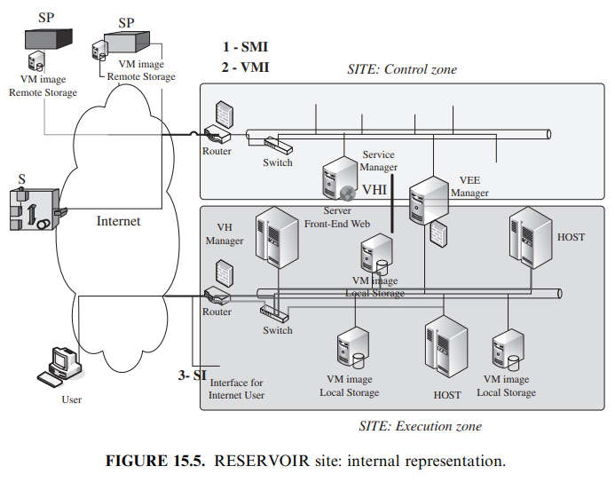

Slide 24
The control zone can be considered a trusted area.
Some threats can appear through the SMI and VEEM interfaces, since they fall into the same cases of external threats.
The firewall located next to the router increases the trust worthiness.
In this zone the weak ring of the system is represented by the VEEM.
It is the bridge between two areas, and it allows the exchange of data among the zones.
Figure 15.5 shows a firewall close to the VEEM, added to prevent any attacks from the execution area.

Slide 25
The zone with a high level of risk is represented by the execution zone.
This area shares all the hardware components.
The hypervisor (VEEH) uses the network, storage, CPU, and ram (host) to load and execute all the VEEs.
The internal threats related to this can be classified as follows:
(1) threats linked to authentication/communication of SPs and other RESERVOIR site;
(2) threats related to misbehavior of service resource allocation
(3) data export control legislation—on an international cloud or between two clouds;
(4) threats linked to fake command for placement of VEEs & compromising the data integrity of the distributed file system
(5) storage data compromising (fake VEE image);
(6) threats linked to compromise data privacy;
(7) threats linked to the underlying hypervisor and OS (VEE could break hypervisor/ underlying OS security and access other VEE); and
(8) data partitioning between VEE.

Slide 26
To avoid any fraudulent access, VEEH has to verify authentication/ communication of SPs and other RESERVOIR sites.
Thus, the same behavior is analyzed for all the communications in external threats.
RESERVOIR site has to guarantee different types of isolation—that is, runtime isolation, network isolation, and storage isolation.
Runtime isolation - resolves all security problems with the underlying OS. - hypervisor security mechanisms need to be used to provide the isolation.
Network isolation - addressed via dynamic configuration of network policies & via virtual circuits that involve routers and switches.
To avoid fake VEE image loading & do not compromise data privacy, storage isolation has to be performed & secure protocols has to be used.
The RESERVOIR site administrator needs to know at any time the state of threats, with a strong monitoring of the execution zone, through the runtime intrusion detection.

